Slide 1
UNIT IV CN

Slide 2
Transport Service
Upper Layer Services
Transport Service Primitives
Berkeley Sockets
Example of Socket Programming: Internet File Server
4/6/2020

Slide 3
Together with the network layer, the transport layer is the heart of the protocol hierarchy.
The network layer provides end-to-end packet delivery using data grams or virtual circuits.
The transport layer builds on the network layer to pro vide data transport from a process on a source machine to a process on a destination machine.

Slide 4
The Transport Layer
To allow transport
users layer
to
access
the
transport service, the
must
provide
some operations to
application programs, that is, a transport service interface.
4/6/2020

Slide 5
The ultimate goal of the transport layer is to provide efficient, reliable, and cost-effective data transmission service to its users, normally processes in the application layer.
To achieve this, the transport layer makes use of the services provided by the network layer.
The software and/or hardware within the transport layer that does the work is called the transport entity.
The transport entity can be located in the operating system kernel, in a library package bound into network applications, in a separate user process, or even on the network interface card.
The first two options are most common on the Internet. The (logical) relationship of the network, transport, and application layers is illustrated in Fig.

Slide 6
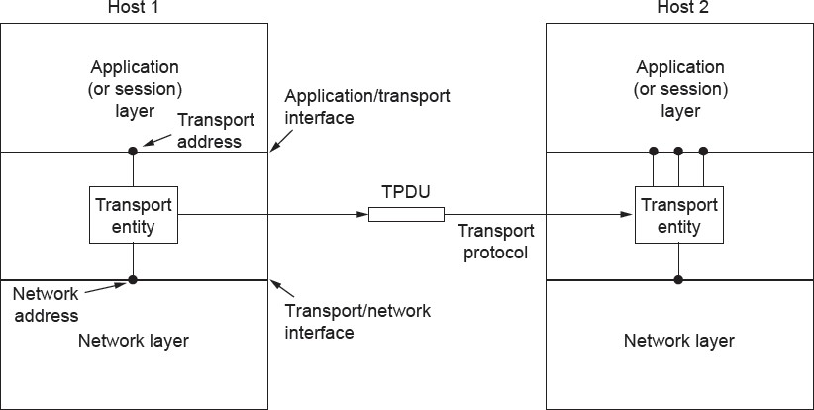
Services Provided to the Upper Layers
The network, transport, and application layers
4

Slide 7
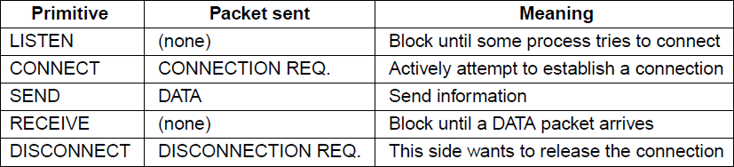
Transport Service Primitives (1)
The primitives for a simple transport service
5
4/6/2020

Slide 8
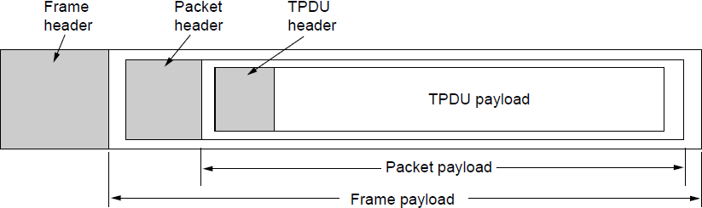
Transport Service Primitives (2)
Nesting of TPDU (Transport Protocol Data Unit) s, packets, and
frames.
4/6/2020 6

Slide 9
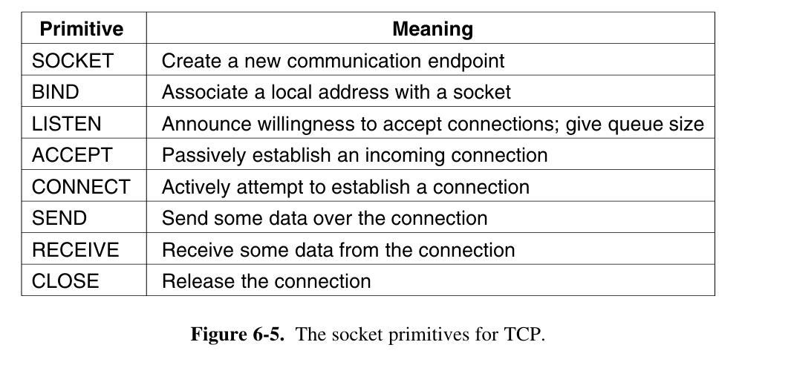
Berkeley Sockets

Slide 10
Elements of Transport Protocols
Addressing
Connection establishment
Connection release
Error control and flow control
Multiplexing
Crash recovery

Slide 11
Similarity between data link and transport layer
Connection establishment
Connection release
Error control and flow control
4/6/2020

Slide 12
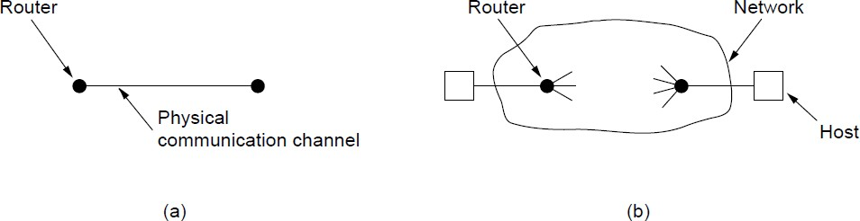
Elements of Transport Protocols (2)
Environment of the data link layer.
Environment of the transport layer.
4/6/2020

Slide 13
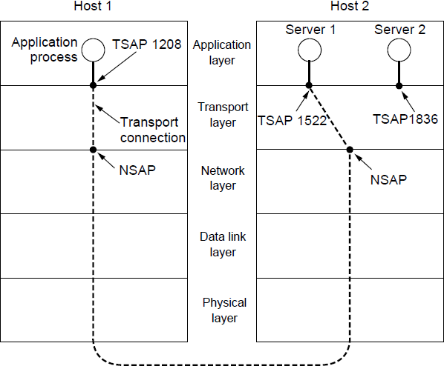
Addressing
TSAPs, NSAPs, and transport connections
4/6/2020

Slide 14
Addressing (2)
A possible scenario for a transport connection is as follows:
A mail server process attaches itself to TSAP 1522 on host 2 to wait for an incoming call. How a process attaches itself to a TSAP is outside the networking model and depends entirely on the local operating system. A call such as our LISTEN might be used, for example.
An application process on host 1 wants to send an email message, so it attaches itself to TSAP 1208 and issues a CONNECT request. The request specifies TSAP 1208 on host 1 as the source and TSAP 1522 on host 2 as the destination. This action ultimately results in a transport connection being established between the application process and the server.

Slide 15
Addressing (3)
The application process sends over the mail message.
The mail server responds to say that it will deliver the message.
The transport connection is released.
4/6/2020

Slide 16
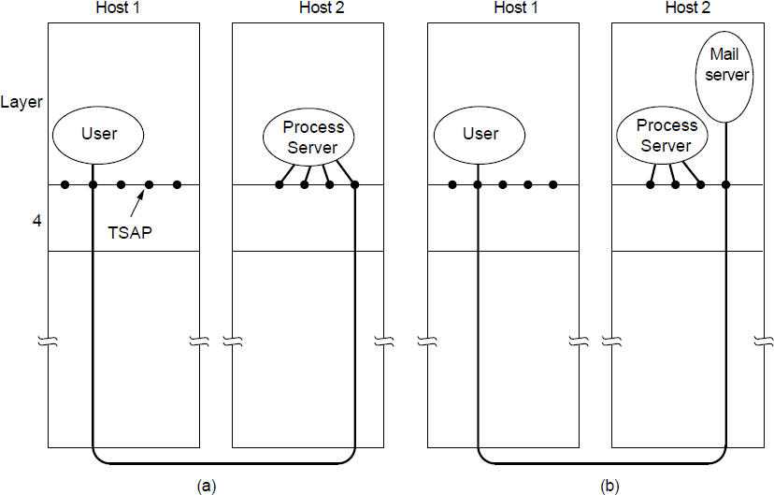
Addressing (4)
How a user process in host 1 establishes a connection
^{4/6/20}w²i⁰th a mail server in host 2 via a proces¹s³server.

Slide 17
Connection Establishment (1)
Techniques for restricting packet lifetime
Throwaway transport addresses
Each connection a identifier <Peer transport entity, connection entity>
4/6/2020

Slide 18
Connection Establishment (2)
Maintain history problem if crashed
Restricted network design.
Putting a hop counter in each packet.
Timestamping each packet.
Also acknowledgement needs to be erased with time T
4/6/2020

Slide 19
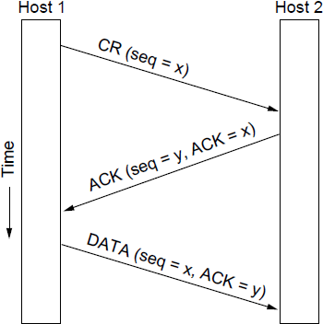
Connection Establishment (3)
Three protocol scenarios for establishing a connection using a
three-way handshake. CR denotes CONNECTION REQUEST.
Normal operation.
4/6/2020 16

Slide 20
Fig. 6-11(a). Host 1 chooses a sequence number, x, and sends a CONNECTION REQUEST segment containing it to host 2. Host 2 replies with an ACK segment acknowledging x and announcing its own initial se quence number, y. Finally, host 1 acknowledges host 2’s choice of an initial se quence number in the first data segment that it sends.

Slide 21
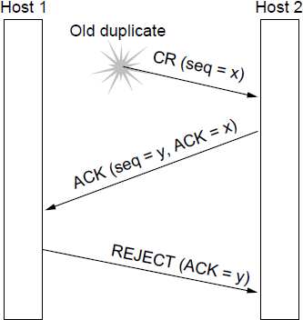
Connection Establishment (4)
Three protocol scenarios for establishing a connection using a
three-way handshake. CR denotes CONNECTION REQUEST. Old duplicate CONNECTION REQUEST appearing out of nowhere.
4/6/2020

Slide 22
In Fig. 6-11(b), the first segment is a delayed dupli cate CONNECTION REQUEST from an old connection. This segment arrives at host 2 without host 1’s knowledge.
Host 2 reacts to this segment by sending host 1anACK segment, in effect asking for verification that host 1 was indeed trying to set up a new connection.
When host 1 rejects host 2’s attempt to establish a connection, host 2 realizes that it was tricked by a delayed duplicate and abandons the connection. In this way, a delayed duplicate does no damage.

Slide 23
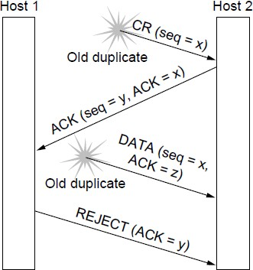
Connection Establishment (5)
Three protocol scenarios for establishing a connection using a three-way handshake. CR denotes CONNECTION REQUEST. Duplicate CONNECTION REQUEST and duplicate ACK
4/6/2020

Slide 24
Fig. 6-11(c). As in the previous example, host 2 gets a delayed CONNECTION REQUEST and replies to it. At this point, it is crucial to realize that host 2 has proposed using y as the initial sequence number for host 2 to host 1 traffic, knowing full well that no seg ments containing sequence number y or acknowledgements to y are still in exist ence. When the second delayed segment arrives at host 2, the fact that z has been acknowledged rather than y tells host 2 that this, too, is an old duplicate.

Slide 25
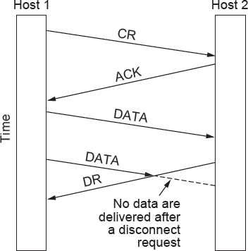
Connection Release (1)
Abrupt disconnection with loss of data – one way release or two
way release
4/6/2020 19

Slide 26
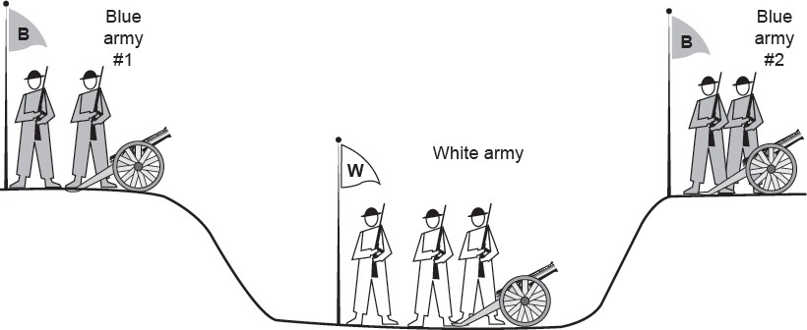
Connection Release (2)
The two-army problem Synchronize which will go on infinit2e0ly
4/6/2020

Slide 27
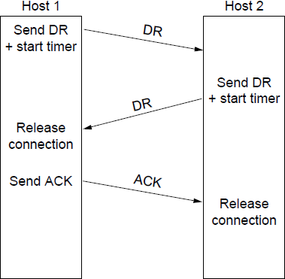
Connection Release (3)
Four protocol scenarios for releasing a connection.
(a) Normal case of three-way han₂₁dshake
4/6/2020

Slide 28
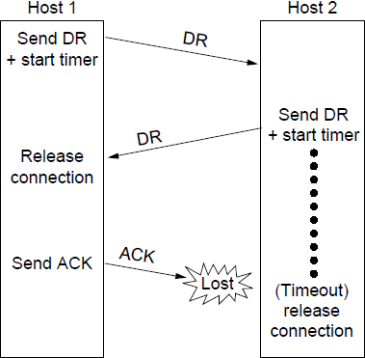
Connection Release (4)
Four protocol scenarios for releasing a connection.
(b) Final ACK lost.
4/6/2020 22

Slide 29
If the final ACK segment is lost, as shown in Fig. 6-14(b), the situation is saved by the timer. When the timer expires, the connection is released anyway.

Slide 30
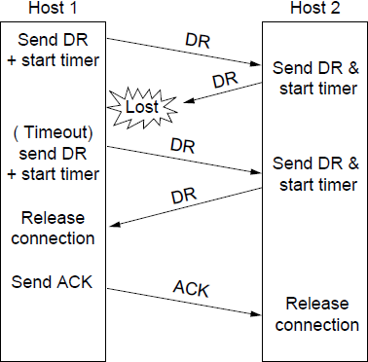
Connection Release (5)
Four protocol scenarios for releasing a connection.
(c) Response lost
4/6/2020 23

Slide 31


Slide 32
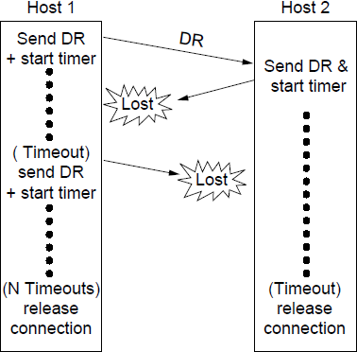
Connection Release (6)
Four protocol scenarios for releasing a connection.
_{4/6/2020} (d) Response lost and subsequent D₂R₄ s lost.

Slide 33
Error Control and Flow Control (1)
Error control is ensuring that the data is delivered with the desired level of reliability, usually that all of the data is delivered without any errors.
Flow control is keeping a fast transmitter from overrunning a slow receiver.
4/6/2020
25

Slide 34
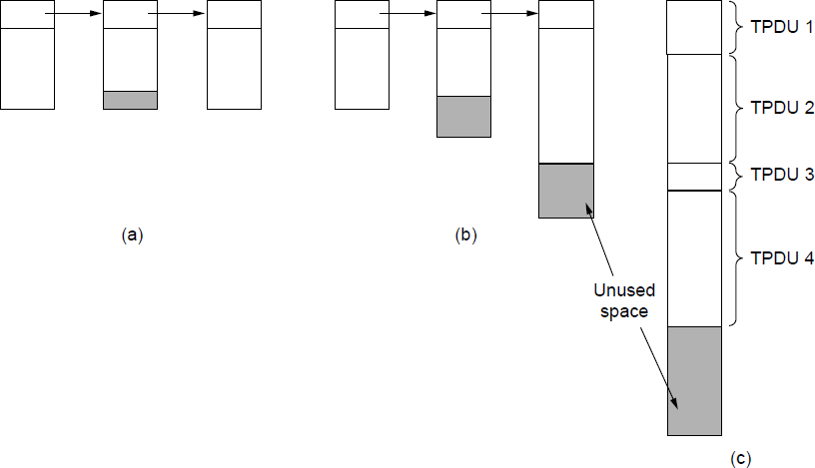
Error Control and Flow Control (2)
(a) Chained fixed-size buffers. (b) Chained variable-sized
_{4/6/2}b₀u₂₀ffers. (c) One large circular buffer per ₂c₆onnection.

Slide 35
Error Control and Flow Control (3)
As a very brief recap:
A frame carries an error-detecting code (e.g., a CRC or checksum) that is used to check if the information was correctly received.
A frame carries a sequence number to identify itself and is retransmitted by the sender until it receives an acknowledgement of successful receipt from the receiver. This is called ARQ (Automatic Repeat reQuest).
There is a maximum number of frames that the sender will allow to be outstanding at any time, pausing if the receiver is not acknowledging frames quickly enough. If this maximum is one packet the protocol is called stop-and-wait. Larger windows enable pipelining and improve performance on long, fast links.
The sliding window protocol combines these features and is also used to support bidirectional data transfer.
4/6/2020

Slide 36
For low-bandwidth bursty traffic, it is better not allot buffer but
dynamically allot buffer
Decouple sliding window protoco;
4/6/2020

Slide 37
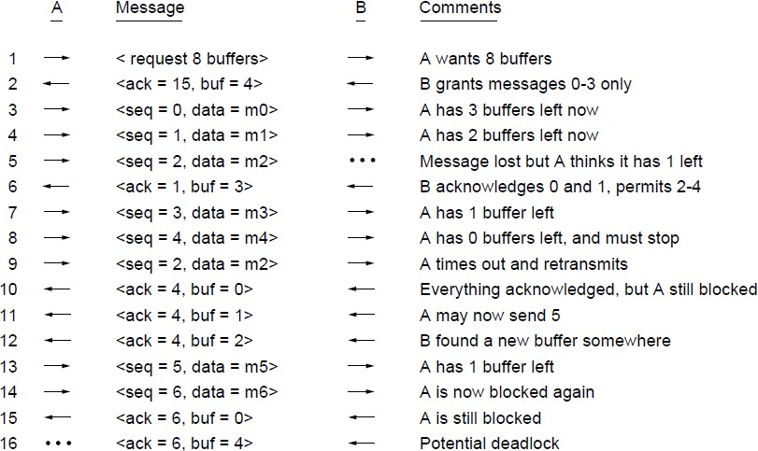
Error Control and Flow Control (2)
Dynamic buffer allocation. The arrows show the direction of
_{4/6/2020}transmission. An ellipsis (...) indicates₂₉a lost TPDU

Slide 38
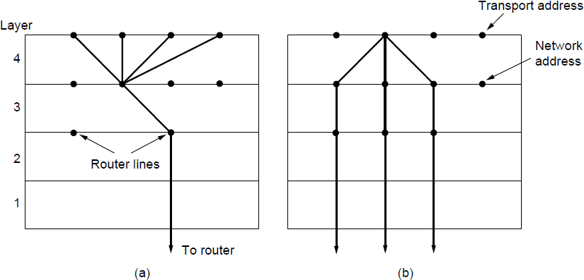
Multiplexing
(a) Multiplexing. (b) Inverse multiplexing.
30
4/6/2020

Slide 39
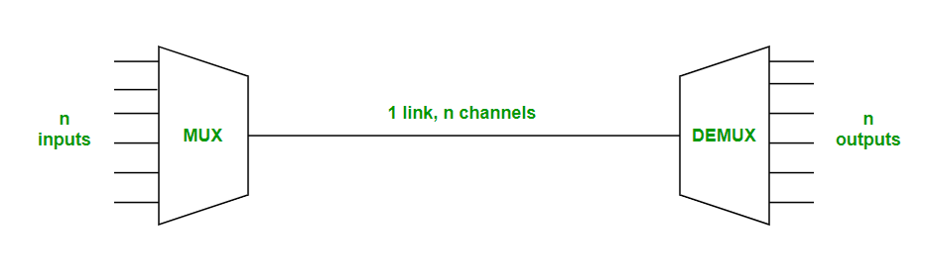
Why Multiplexing?
Multiplexing is the sharing of a medium or bandwidth. It is the process in which multiple signals coming from multiple sources are combined and transmitted over a single communication/physical line.
Multiplexing in computer networks is done using a device Multiplexer called MUX that takes 'n' input lines to generate a single output line.
On the other hand, there is a device called DEMUX(Demultiplexer) that takes a single input line and generates 'n' output lines.

Slide 40
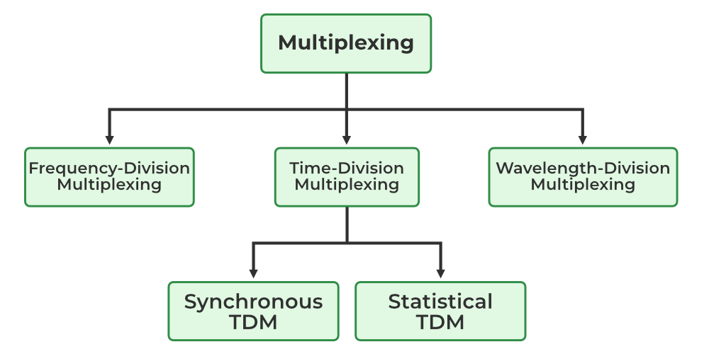

Slide 41
Crash Recovery
No matter how the client and server are programmed, there are always situations where the protocol fails to recover properly.
The server can be programmed in one of two ways: acknowledge first or write first.
The client can be programmed in one of four ways:
always retransmit the last segment, never retransmit the last segment, retransmit only in state S0, retransmit only in state S1.
This g_{4/}i₆v/e₂₀s₂₀eight combinations.
31

Slide 42
Server side events
Three events are possible at the server:
sending an acknowledgement (A), writing to the output process (W),
and crashing (C).
The three events can occur in six different orderings: AC(W), AWC, C(AW), C(WA), WAC, and WC(A), where the parentheses are used to indicate that neither A nor W can follow C (i.e., once it has crashed, it has crashed).
4/6/2020

Slide 43
Client Side Events
The client can be programmed in one of four ways:
always retransmit the last segment,
never retransmit the last segment,
retransmit only in state S0,
retransmit only in state S1.
Each client can be in one of two states:
one segment outstanding, S1, or
no segments outstanding, S0
4/6/2020

Slide 44
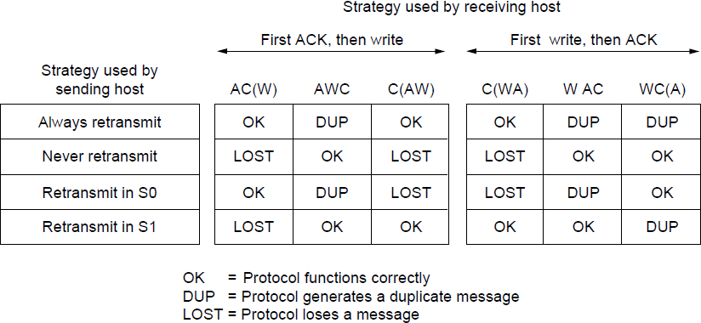
Crash Recovery
Different combinations of client and server strategy
4/6/2020

Slide 45
The Internet Transport Protocols: TCP (1)
Introduction to TCP
The TCP service model
The TCP protocol
The TCP segment header
TCP connection establishment
TCP connection release
4/6/2020

Slide 46
THE INTERNET TRANSPORT PROTOCOLS: UDP
The Internet has two main protocols in the transport layer, a connectionless protocol and a connection-oriented one. The protocols complement each other.
The connectionless protocol is UDP. It does almost nothing beyond sending packets between applications, letting applications build their own protocols on top as needed.
The connection-oriented protocol is TCP. It does almost everything. It makes connections and adds reliability with retransmissions, along with flow control and congestion control, all on behalf of the applications that use it.
The Internet protocol suite supports a connectionless transport protocol called UDP (User Datagram Protocol). UDP provides a way for applications to send encapsulated IP datagrams without having to establish a connection. UDP is described in RFC 768.

Slide 47
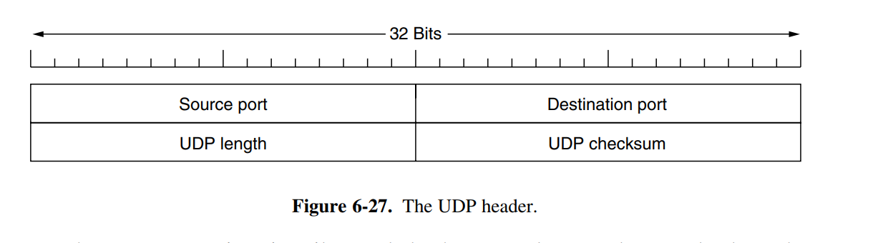
UDP transmits segments consisting of an 8-byte header followed by the payload. The header is shown in Fig. 6-27. The two ports serve to identify the endpoints within the source and destination machines. When a UDP packet arrives, its payload is handed to the process attached to the destination port.

Slide 48
The source port is primarily needed when a reply must be sent back to the source. By copying the Source port field from the incoming segment into the Destination port field of the outgoing segment, the process sending the reply can specify which process on the sending machine is to get it.
The UDP length field includes the 8-byte header and the data. The minimum length is 8 bytes, to cover the header. The maximum length is 65,515 bytes, which is lower than the largest number that will fit in 16 bits because of the size limit on IP packets.
An optional Checksum is also provided for extra reliability. It checksums the header, the data, and a conceptual IP pseudoheader

Slide 49
THE INTERNET TRANSPORT PROTOCOLS: TCP
TCP (Transmission Control Protocol) was specifically designed to provide a reliable end-to-end byte stream over an unreliable internetwork. An internetwork differs from a single network because different parts may have wildly different topologies, bandwidths, delays, packet sizes, and other parameters. TCP was designed to dynamically adapt to properties of the internetwork and to be robust in the face of many kinds of failures.
The IP layer gives no guarantee that datagrams will be delivered properly, nor any indication of how fast datagrams may be sent.
It is up to TCP to send datagrams fast enough to make use of the capacity but not cause congestion, and to time out and retransmit any datagrams that are not delivered.
Datagrams that do arrive may well do so in the wrong order; it is also up to TCP to reassemble them into messages in the proper sequence.
In short, TCP must furnish good performance with the reliability that most applications want and that IP does not provide.

Slide 50
The TCP Service Model
TCP service is obtained by both the sender and the receiver creating end points, called sockets,Each socket has a socket number (address) consisting of the IP address of the host and a 16-bit number local to that host, called a port.
A port is the TCP name for a TSAP. For TCP service to be obtained, a connection must be explicitly established between a socket on one machine and a socket on another machine.
A socket may be used for multiple connections at the same time. In other words, two or more connections may terminate at the same socket. Connections are identified by the socket identifiers at both ends, that is, (socket1, socket2). No virtual circuit numbers or other identifiers are used.
All TCP connections are full duplex and point-to-point. Full duplex means that traffic can go in both directions at the same time. Point-to-point means that each connection has exactly two end points. TCP does not support multicasting or broadcasting.

Slide 51
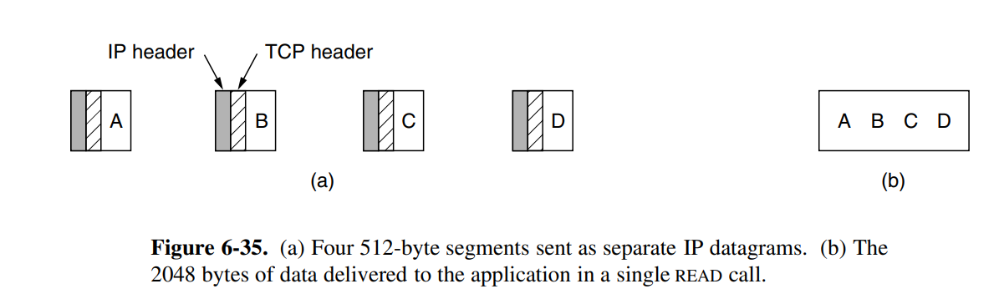
A TCP connection is a byte stream, not a message stream. Message boundaries are not preserved end to end. For example, if the sending process does four 512-byte writes to a TCP stream, these data may be delivered to the receiving process as four 512-byte chunks, two 1024-byte chunks, one 2048-byte chunk (see Fig. 6-35), or some other way. There is no way for the receiver to detect the unit(s) in which the data were written, no matter how hard it tries.

Slide 52
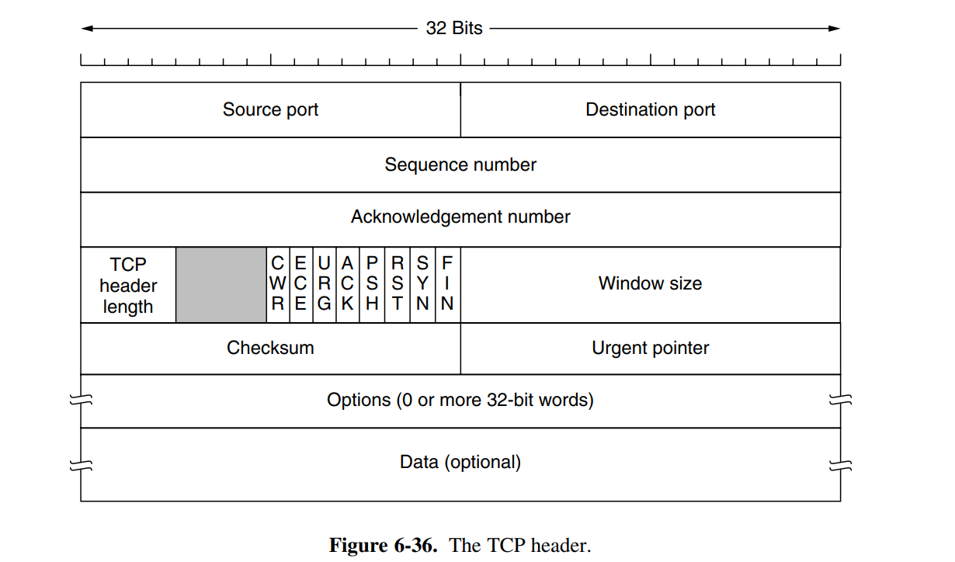
The TCP Segment Header
Figure 6-36 shows the layout of a TCP segment. Every segment begins with a fixed-format, 20-byte header. The fixed header may be followed by header options. After the options, if any, up to 65,535 − 20 − 20 = 65,495 data bytes may follow, where the first 20 refer to the IP header and the second to the TCP header.

Slide 53
The Source port and Destination port fields identify the local end points of the connection.
The Sequence number and Acknowledgement number fields perform their usual functions. Note that the latter specifies the next in-order byte expected, not the last byte correctly received.
The TCP header length tells how many 32-bit words are contained in the TCP header.
Next comes a 4-bit field that is not used.
Now come eight 1-bit flags.
CWR and ECE are used to signal congestion.
URG is set to 1 if the Urgent pointer is in use. The Urgent pointer is used to indicate a byte offset from the current sequence number at which urgent data are to be found.
The ACK bit is set to 1 to indicate that the Acknowledgement number is valid. This is the case for nearly all packets. If ACK is 0, the segment does not contain an acknowledgement, so the Acknowledgement number field is ignored.
The PSH bit indicates PUSHed data. The receiver is hereby kindly requested to deliver the data to the application upon arrival and not buffer it until a full buffer has been received .
The RST bit is used to abruptly reset a connection that has become confused due to a host crash or some other reason. It is also used to reject an invalid segment or refuse an attempt to open a connection. In general, if you get a segment with the RST bit on, you have a problem on your hands.

Slide 54
The SYN bit is used to establish connections. The connection request has SYN = 1 and ACK = 0 to indicate that the piggyback acknowledgement field is not in use. The connection reply does bear an acknowledgement, however, so it has SYN = 1 and ACK = 1. In essence, the SYN bit is used to denote both CONNECTION REQUEST and CONNECTION ACCEPTED, with the ACK bit used to distinguish between those two possibilities.
The FIN bit is used to release a connection. It specifies that the sender has no more data to transmit. However, after closing a connection, the closing process may continue to receive data indefinitely.
Flow control in TCP is handled using a variable-sized sliding window. The Window size field tells how many bytes may be sent starting at the byte acknowledged.
A Checksum is also provided for extra reliability.
The Options field provides a way to add extra facilities not covered by the regular header. Many options have been defined and several are commonly used. The options are of variable length, fill a multiple of 32 bits by using padding with zeros, and may extend to 40 bytes to accommodate the longest TCP header that can be specified.

Slide 55
Real-Time Transport Protocols
Client-server RPC is one area in which UDP is widely used.
Another one is for real-time multimedia applications. In particular, as Internet radio, Internet telephony, music-on-demand, videoconferencing, video-on-demand, and other multimedia applications became more commonplace, people have discovered that each application was reinventing more or less the same real-time transport protocol.
It gradually became clear that having a generic real-time transport protocol for multiple applications would be a good idea.
Thus was RTP (Real-time Transport Protocol) born. It is described in RFC 3550 and is now in widespread use for multimedia applications.
We will describe two aspects of real-time transport.
The first is the RTP protocol for transporting audio and video data in packets.
The second is the processing that takes place, mostly at the receiver, to play out the audio and video at the right time.

Slide 56
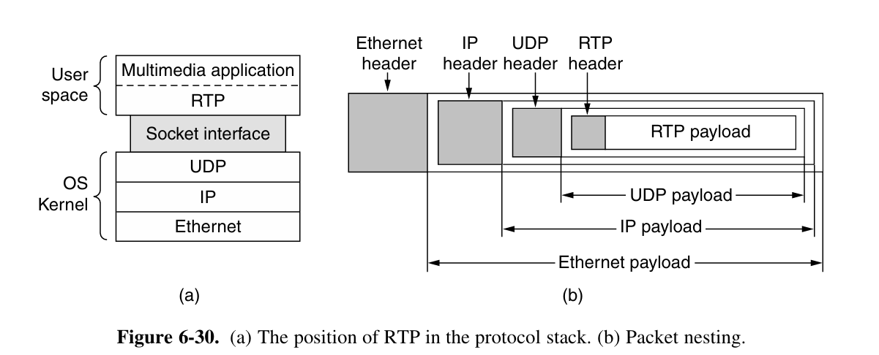

Slide 57
RTP normally runs in user space over UDP (in the operating system).
It operates as follows. The multimedia application consists of multiple audio, video, text, and possibly other streams. These are fed into the RTP library, which is in user space along with the application.
This library multiplexes the streams and encodes them in RTP packets, which it stuffs into a socket.
On the operating system side of the socket, UDP packets are generated to wrap the RTP packets and handed to IP for transmission over a link such as Ethernet.
The reverse process happens at the receiver. The multimedia application eventually receives multimedia data from the RTP library. It is responsible for playing out the media.

Slide 58
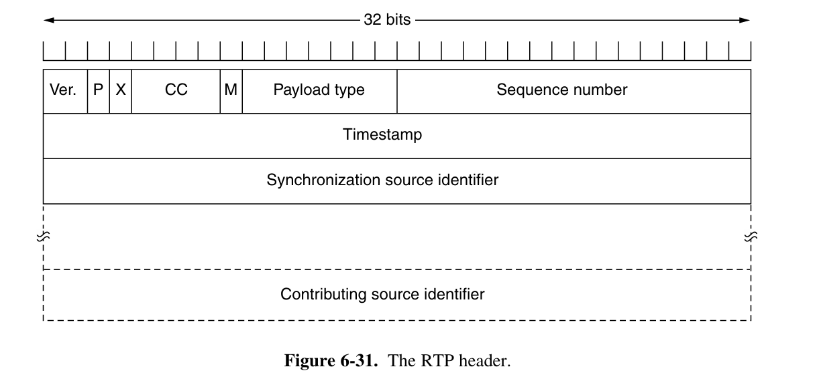

Slide 59
The header format of RTP is very simple and it covers all real-time applications. The explanation of each field of header format is given below:
Version : This 2-bit field defines version number. The current version is 2.
  P - The length of this field is 1-bit. If value is 1, then it denotes presence of padding at end of packet and if value is 0, then there is no padding.
  X - The length of this field is also 1-bit. If value of this field is set to 1, then its indicates an extra extension header between data and basic header and if value is 0 then, there is no extra extension.
  Contributor count - This 4-bit field indicates number of contributors. Here maximum possible number of contributor is 15 as a 4-bit field can allows number from 0 to 15.

Slide 60
M - The length of this field is 1-bit and it is used as end marker by application to indicate end of its data.
Payload types - This field is of length 7-bit to indicate type of payload. We list applications of some common types of payload.
Sequence Number - The length of this field is 16 bits. It is used to give serial numbers to RTP packets. It helps in sequencing. The sequence number for first packet is given a random number and then every next packet’s sequence number is incremented by 1. This field mainly helps in checking lost packets and order mismatch.
Time Stamp - The length of this field is 32-bit. It is used to find relationship between times of different RTP packets. The timestamp for first packet is given randomly and then time stamp for next packets given by sum of previous timestamp and time taken to produce first byte of current packet. The value of 1 clock tick is varying from application to application.

Slide 61
Synchronization Source Identifier - This is a 32-bit field used to identify and define the source. The value for this source identifier is a random number that is chosen by source itself. This mainly helps in solving conflict arises when two sources started with the same sequencing number.
Contributor Identifier - This is also a 32-bit field used for source identification where there is more than one source present in session. The mixer source use Synchronization source identifier and other remaining sources (maximum 15) use Contributor identifier.

Slide 62
TCP CONNECTION ESTABLISHMENT
Connections are established in TCP by means of the three-way handshake discussed.
To establish a connection, one side, say, the server, passively waits for an incoming connection by executing the LISTEN and ACCEPT primitives in that order, either specifying a specific source or nobody in particular.
The other side, say, the client, executes a CONNECT primitive, specifying the IP address and port to which it wants to connect, the maximum TCP segment size it is willing to accept, and optionally some user data (e.g., a password).
The CONNECT primitive sends a TCP segment with the SYN bit on and ACK bit off and waits for a response.

Slide 63
If some process is listening to the port, that process is given the incoming TCP segment. It can either accept or reject the connection.
If it accepts, an acknowledgement segment is sent back.
The sequence of TCP segments sent in the normal case is shown in Fig. 6-37(a). Note that a SYN segment consumes 1 byte of sequence space so that it can be acknowledged unambiguously.
In the event that two hosts simultaneously attempt to establish a connection between the same two sockets, the sequence of events is as illustrated in Fig. 6- 37(b).
The result of these events is that just one connection is established, not two, because connections are identified by their end points.
If the first setup results in a connection identified by (x, y) and the second one does too, only one table entry is made, namely, for (x, y)

Slide 64
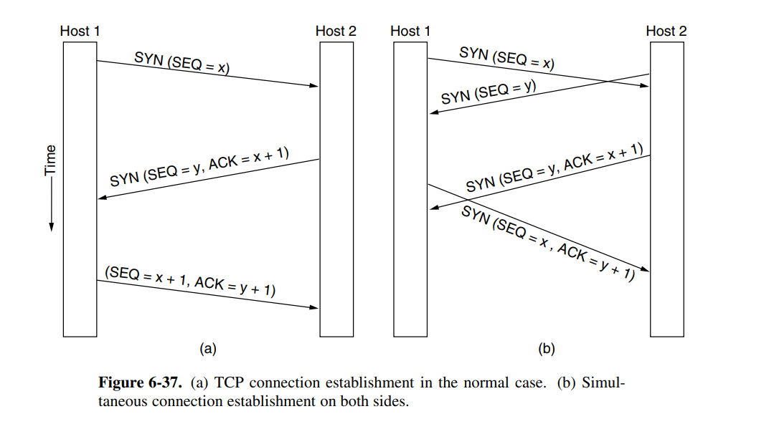
TCP CONNECTION ESTABLISHMENT

Slide 65
TCP Connection Release
To release a connection, either party can send a TCP segment with the FIN bit set, which means that it has no more data to transmit.
When the FIN is acknowledged, that direction is shut down for new data.
Data may continue to flow indefinitely in the other direction, however. When both directions have been shut down, the connection is released
Normally, four TCP segments are needed to release a connection: one FIN and one ACK for each direction. However, it is possible for the first ACK and the second FIN to be contained in the same segment, reducing the total count to three.
Just as with telephone calls in which both people say goodbye and hang up the phone simultaneously, both ends of a TCP connection may send FIN segments at the same time.
These are each acknowledged in the usual way, and the connection is shut down. There is, in fact, no essential difference between the two hosts releasing sequentially or simultaneously.

Slide 66
TCP Connection Management Modeling
The steps required to establish and release connections can be represented in a finite state machine with the 11 states listed in Fig. 6-38. In each state, certain events are legal.
When a legal event happens, some action may be taken. If some other event happens, an error is reported.
Each connection starts in the CLOSED state. It leaves that state when it does either a passive open (LISTEN) or an active open (CONNECT). If the other side does the opposite one, a connection is established and the state becomes ESTABLISHED. Connection release can be initiated by either side. When it is complete, the state returns to CLOSED.

Slide 67
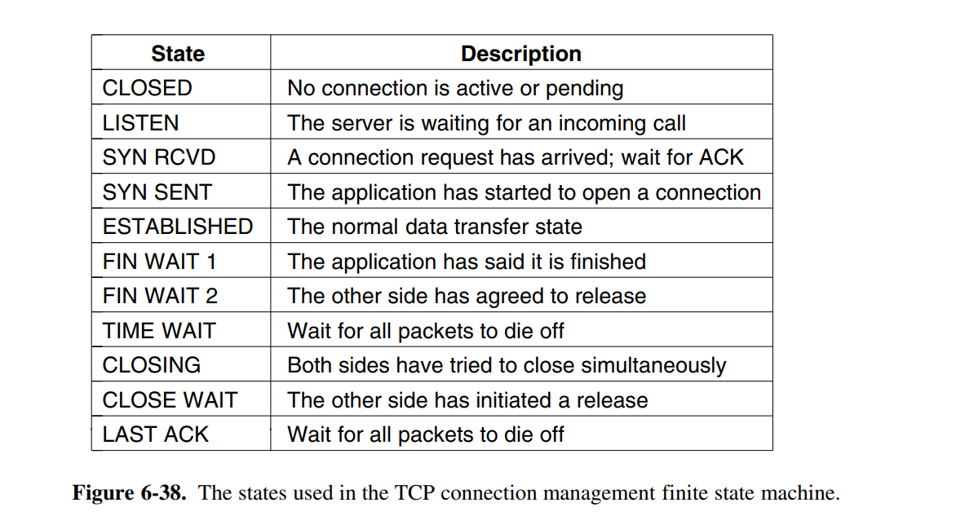

Slide 68
The finite state machine itself is shown in Fig. 6-39. The common case of a client actively connecting to a passive server is shown with heavy lines—solid for the client, dotted for the server. The lightface lines are unusual event sequences.
Each line in Fig. 6-39 is marked by an event/action pair. The event can either be a user-initiated system call (CONNECT, LISTEN, SEND, or CLOSE), a segment arrival (SYN, FIN, ACK, or RST), or, in one case, a timeout of twice the maximum packet lifetime. The action is the sending of a control segment (SYN, FIN, or RST) or nothing, indicated by —. Comments are shown in parentheses.

Slide 69
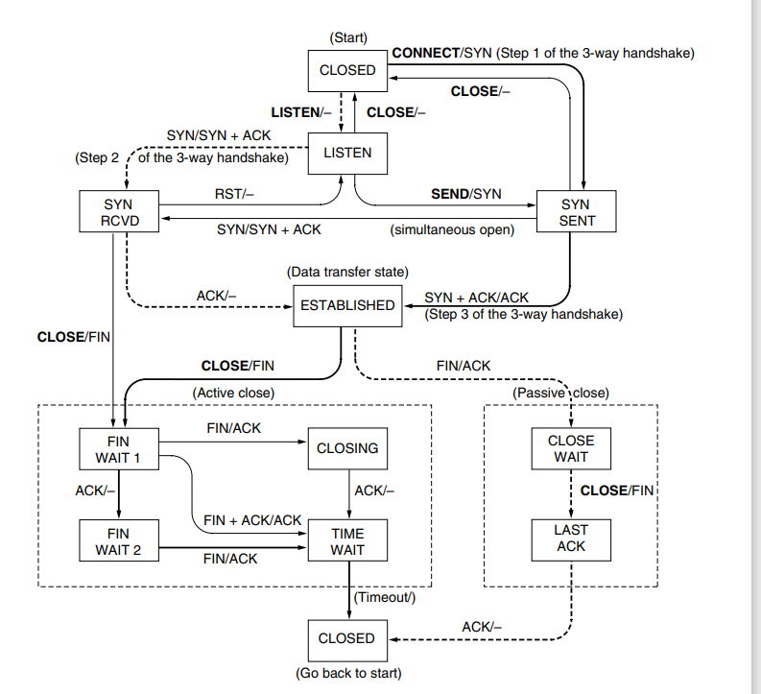

Slide 70
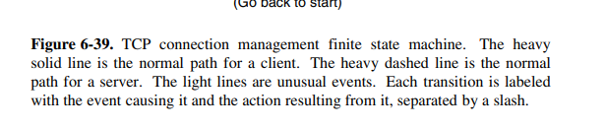

Slide 71
TCP Timer Management
TCP uses multiple timers (at least conceptually) to do its work.
The most important of these is the RTO (Retransmission TimeOut).
When a segment is sent, a retransmission timer is started. If the segment is acknowledged before the timer expires, the timer is stopped.
If, on the other hand, the timer goes off before the acknowledgement comes in, the segment is retransmitted (and the timer os started again).
The question that arises is: how long should the timeout be?
If the timeout is set too short, say, T1 unnecessary retransmissions will occur, clogging the Internet with useless packets.
If it is set too long (e.g., T2), performance will suffer due to the long retransmission delay whenever a packet is lost.

Slide 72
The solution is to use a dynamic algorithm that constantly adapts the timeout interval, based on continuous measurements of network performance.
The algorithm generally used by TCP is due to Jacobson (1988) and works as follows.
For each connection, TCP maintains a variable, SRTT (Smoothed Round-Trip Time), that is the best current estimate of the round-trip time to the destination in question.
When a segment is sent, a timer is started, both to see how long the acknowledgement takes and also to trigger a retransmission if it takes too long.
If the acknowledgement gets back before the timer expires, TCP measures how long the acknowledgement took, say, R. It then updates SRTT according to the formula.

Slide 73

where α is a smoothing factor that determines how quickly the old values are forgotten. Typically, α = 7/8. This kind of formula is an EWMA (Exponentially Weighted Moving Average) or low-pass filter that discards noise in the samples

Slide 74
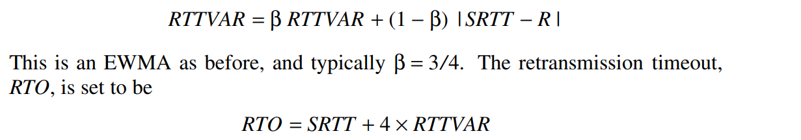

Slide 75
The Persistence Timer (PT) is another important aspect of TCP timers that helps manage network congestion. When there are too many unacknowledged packets on the network, it can lead to congestion and eventually result in packet loss or delay.
The PT prevents this by temporarily holding back new transmissions until previously sent packets are acknowledged.
The PT works by periodically sending probes to check whether there are any unacknowledged packets on the network.
Keepalive Timer
The Keepalive Timer (KT) is used to detect inactive connections.
When a connection is idle for an extended period, it can be challenging to know whether the session has been terminated or not. The KT solves this by sending probes at regular intervals to check the status of the connection.

Slide 76
TCP SLIDING WINDOW
window management in TCP decouples the issues of acknowledgement of the correct receipt of segments and receiver buffer allocation.
For example, suppose the receiver has a 4096-byte buffer, as shown in Fig. 6-40.
If the sender transmits a 2048-byte segment that is correctly received, the receiver will acknowledge the segment.
However, since it now has only 2048 bytes of buffer space (until the application removes some data from the buffer), it will advertise a window of 2048 starting at the next byte expected.

Slide 77
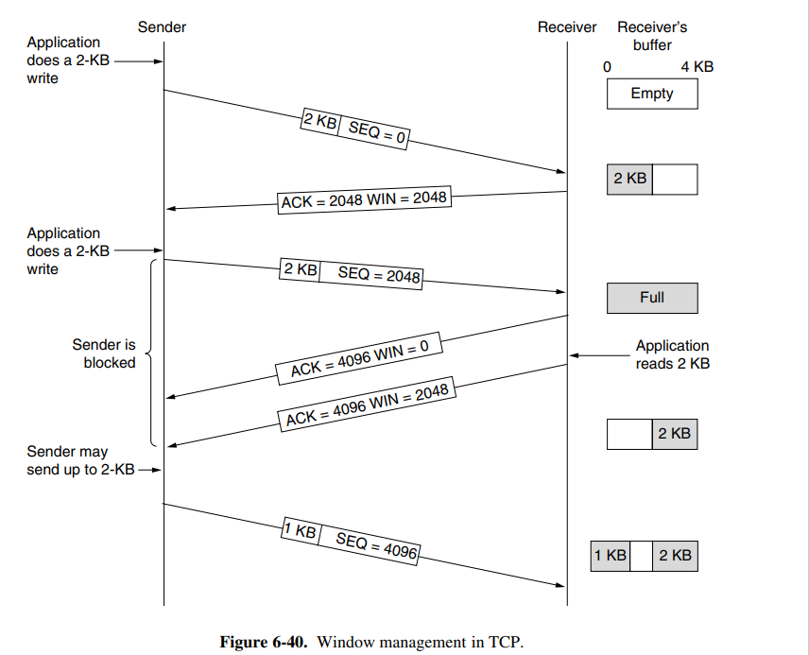

Slide 78
Nagle’s algorithm (Nagle, 1984). What Nagle suggested is simple when data come into the sender in small pieces, just send the first piece and buffer all the rest until the first piece is acknowledged.
Then send all the buffered data in one TCP segment and start buffering again until the next segment is acknowledged. That is, only one short packet can be outstanding at any time.
If many pieces of data are sent by the application in one round-trip time, Nagle’s algorithm will put the many pieces in one segment, greatly reducing the bandwidth used.

Slide 79
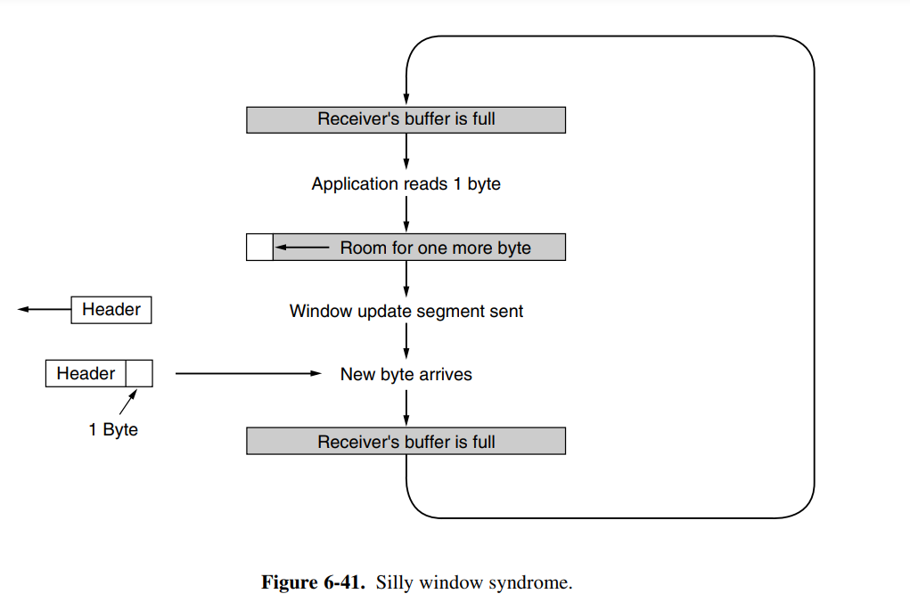
Another problem that can degrade TCP performance is the silly window syndrome (Clark, 1982). This problem occurs when data are passed to the sending TCP entity in large blocks, but an interactive application on the receiving side reads data only 1 byte at a time.

Slide 80
TCP Congestion Control
TCP congestion control is a method used by the TCP protocol to manage data flow over a network and prevent congestion.
TCP uses a congestion window and congestion policy that avoids congestion.
Previously, we assumed that only the receiver could dictate the sender’s window size.
We ignored another entity here, the network. If the network cannot deliver the data as fast as it is created by the sender, it must tell the sender to slow down.
In other words, in addition to the receiver, the network is a second entity that determines the size of the sender’s window

Slide 81
Congestion Policy in TCP
Slow Start Phase: Starts slow increment is exponential to the threshold.
Congestion Avoidance Phase: After reaching the threshold increment is by 1.
Congestion Detection Phase: The sender goes back to the Slow start phase or the Congestion avoidance phase.

Slide 82
Congestion Control
Slow start
The congestion window is doubling every roundtrip time.
This algorithm is called slow start, but it is not slow at all—it is exponential growth.
Slow start is shown in Fig. 6-44. In the first round-trip time, the sender injects one packet into the network (and the receiver receives one packet). Two packets are sent in the next round-trip time, then four packets in the third round-trip time.
Slow-start works well over a range of link speeds and round-trip times, and uses an ack clock to match the rate of sender transmissions to the network path.
Take a look at the way acknowledgements return from the sender to the receiver in Fig. 6-44. When the sender gets an acknowledgement, it increases the congestion window by one and immediately sends two packets into the network.

Slide 83
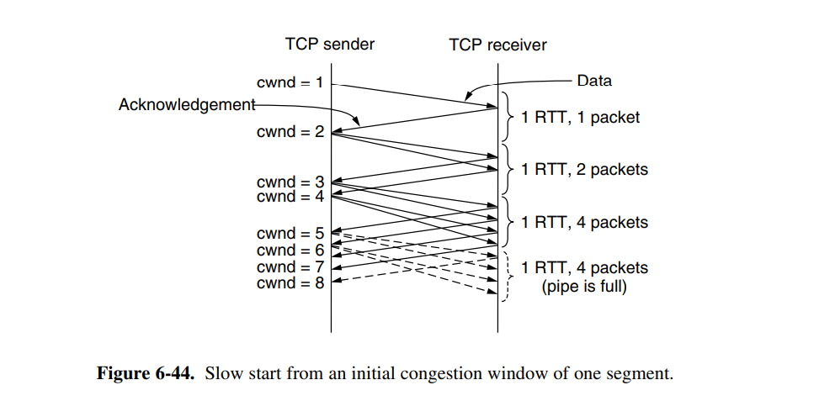

Slide 84
Congestion Avoidance Phase
Additive increment: This phase starts after the threshold value also denoted as ssthresh. The size of cwnd(congestion window) increases additive. After each RTT cwnd = cwnd + 1.
Congestion Detection Phase
Multiplicative decrement: If congestion occurs, the congestion window size is decreased. The only way a sender can guess that congestion has happened is the need to retransmit a segment. Retransmission is needed to recover a missing packet that is assumed to have been dropped by a router due to congestion. Retransmission can occur in one of two cases: when the RTO timer times out or when three duplicate ACKs are received.

